Slide 1


UNIVERSITY INSTITUTE OF ENGINEERING
COMPUTER SCIENCE & ENGINEERING
Introduction to Information Security
(Subject Code:20CST-354/ITT-354)
Prepared By : Er. Puneet kaur(E6913)
INTRODUCTION
DISCOVER . LEARN . EMPOWER

Slide 2
Lecture -2.1
(Key Management)

Slide 3
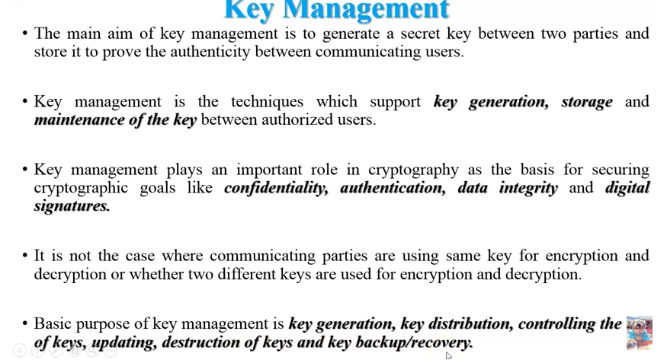

Slide 4
Key Management in Cryptography
Requirements of Key Management
Secrecy of private keys.
Assurance of public keys.
Public Key Infrastructure (PKI)
Digital Certificate
Certifying Authority (CA)

Slide 5
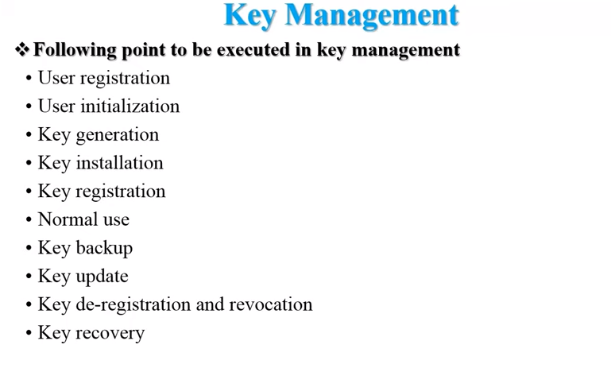

Slide 6
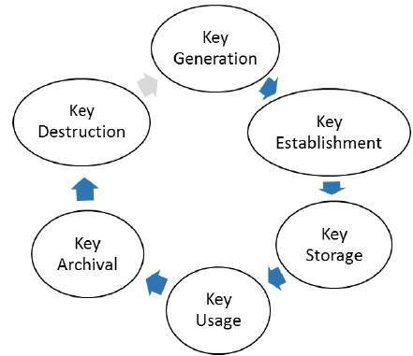
Key Management
Key Life Cycle

Slide 7
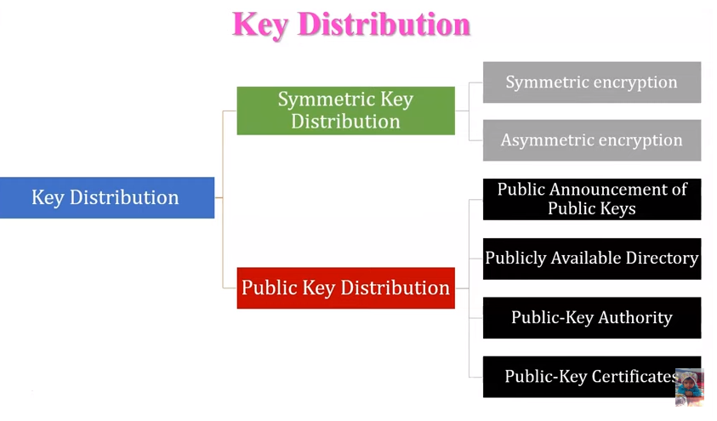

Slide 8
Requirements of Key Management
There are two specific requirements of key management for public key cryptography.
Secrecy of private keys: Secret keys must remain secret from all parties except those who are owner and are authorized to use them.
Assurance of public keys: The public keys are in open domain and seen as public pieces of data.

Slide 9
Public Key Infrastructure (PKI)
PKI provides assurance of public key. It provides the identification of public keys and their distribution.
An anatomy of PKI comprises of the following components:
Public Key Certificate, commonly referred to as ‘digital certificate’.
Private Key tokens.
Certification Authority.
Registration Authority.
Certificate Management System.

Slide 10
Digital Certificate
Digital certificates are based on the ITU standard X.509 which defines a standard certificate format for public key certificates and certification validation.
Public key pertaining to the user client is stored in digital certificates by The Certification Authority (CA) along with other relevant information such as client information, expiration date, usage, issuer etc.
CA digitally signs this entire information and includes digital signature in the certificate.

Slide 11
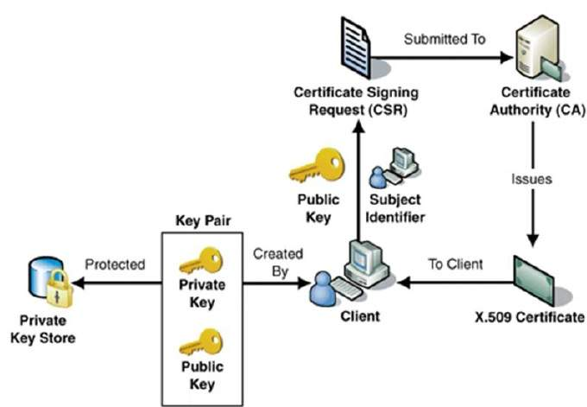
Process of obtaining Digital Certificate
The process of obtaining Digital Certificate by a person/entity is depicted in the following illustration.

Slide 12
Certifying Authority (CA)
The CA issues certificate to a client and assist other users to verify the certificate.
The CA takes responsibility for identifying correctly the identity of the client asking for a certificate to be issued, and ensures that the information contained within the certificate is correct and digitally signs it.
The CA, after duly verifying identity of client, issues a digital certificate to that client.

Slide 13
Key Functions of CA
Generating key pairs: − The CA may generate a key pair independently or jointly with the client.
Issuing digital certificates : − The CA issues a certificate after client provides the credentials to confirm his identity.
Publishing Certificates : CA need to publish certificates so that users can find them.

Slide 14
Key Functions of CA
Verifying Certificates : The CA makes its public key available in environment to assist verification of his signature on clients’ digital certificate.
Revocation of Certificates : CA revokes the certificate issued due to some reason such as compromise of private key by user or loss of trust in the client.
After revocation, CA maintains the list of all revoked certificate that is available to the environment.

Slide 15
Hierarchy of CA
The hierarchical certification model is of interest since it allows public key certificates to be used in environments where two communicating parties do not have trust relationships with the same CA.
The root CA is at the top of the CA hierarchy and the root CA's certificate is a self-signed certificate.
The CAs, which are directly subordinate to the root CA (For example, CA1 and CA2) have CA certificates that are signed by the root CA.
The CAs under the subordinate CAs in the hierarchy (For example, CA5 and CA6) have their CA certificates signed by the higher-level subordinate CAs.

Slide 16
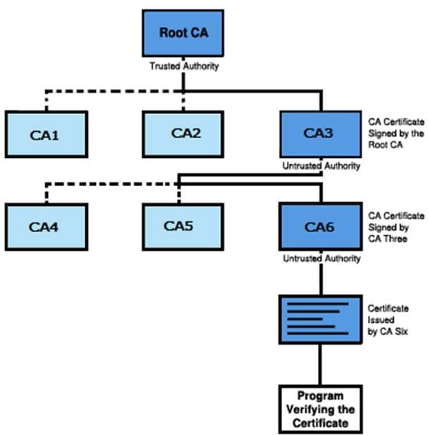
Hierarchy of CA
The following illustration shows a CA hierarchy

Slide 17
Classes of Certificates
There are four typical classes of certificate −
Class 1 − These certificates can be easily acquired by supplying an email address.
Class 2 − These certificates require additional personal information to be supplied.
Class 3 − These certificates can only be purchased after checks have been made about the requestor’s identity.

Slide 18
Classes of Certificates
Class 4 − They may be used by governments and financial organizations needing very high levels of trust.

Slide 19
References
http://www.brainkart.com/article/Classical-Encryption-Techniques_8339/
https://www.tutorialspoint.com/cryptography/index.htm
https://www.geeksforgeeks.org/cryptography-introduction/
https://www.techopedia.com/definition/1770/cryptography#:~:text=Cryptography%20involves%20creating%20written%20or,information%20to%20be%20kept%20secret.&text=Information%20security%20uses%20cryptography%20on,transit%20and%20while%20being%20stored.

Slide 20
E- Books Recommended
https://www.pdfdrive.com/cyber-security-books.html
https://bookauthority.org/books/new-cyber-security-ebooks
https://bookauthority.org/books/best-cyber-security-ebooks
https://www.freetechbooks.com/information-security-f52.html

